Slide 1

$5.50
$85.00

Slide 2
World Bank “Upper Middle Class”
$5.50
$85.00
“Average” College Student
https://blogs.worldbank.org/opendata/nearly-1-2-world-lives-under-550-day or https://bit.ly/5fifty

Slide 3
Security
Parallel
Protocols

Slide 4
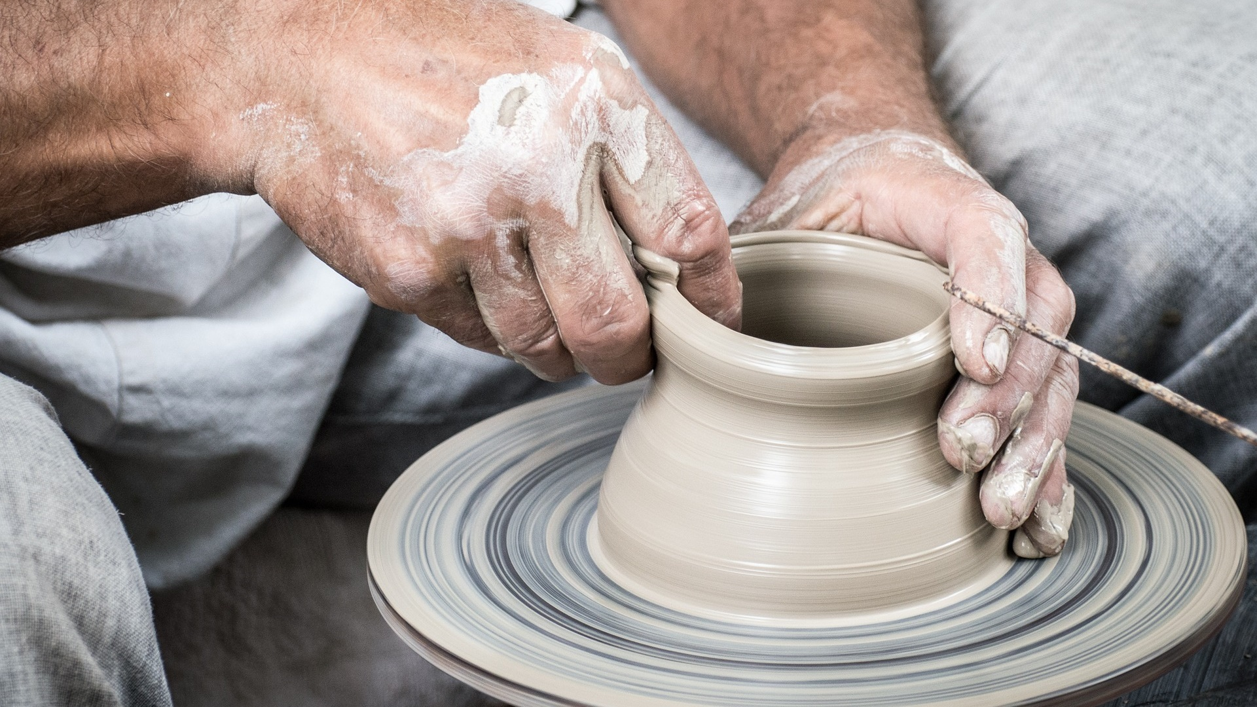

Slide 5


Slide 6
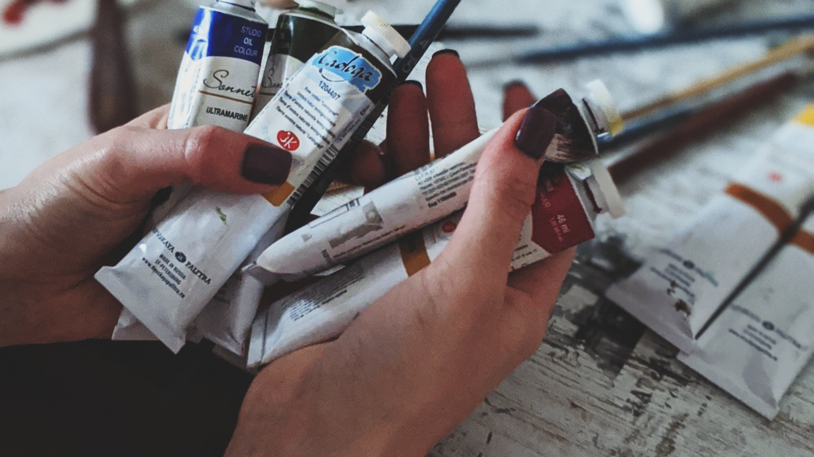

Slide 7


Slide 8
Day 2 – A Sprint-based Class
©Me, meaning not you.
Not that anyone on the internet respects copyright…and I don’t really care that much. Unless you somehow make lots of money from these slides and an attorney convinces me that paying him lots of money will make me lots of money if I sue you. Then we’ll both be in trouble because you’ll be forced to spend lots of money on an attorney to keep yourself from paying even more money if you lose the suit. In short, we both lose big because we have to pay the attorneys. The attorneys win big because they win either way. I have nothing to lose because I don’t have to sue, and if I do, I’m taking a calculated risk—money down on an attorney as the ante on getting big bucks out of a law suit. You have everything to lose (attorney fees, and potentially the suit), but hardly anything to gain. I mean, are these slides really worth copying? Informative, maybe, but copying and using to make gobs of money? The take away? If you’re going to copy these slides, you had better not use them to make enough money that an attorney will hunt me down and convince me that it’s worth paying him/her to sue you. Enough said?

Slide 9


My Philosophy
At home
Less busy-work
More practice
In class
Less stress
More mentoring

Slide 10
Traditional Class
HW
Project
Week 1
HW
HW
HW
Project
HW
Midterm
HW
HW
Project
HW
HW
Midterm
HW
Project
HW
HW
Week 16
Final

Slide 11
Agile Class
Course Intro
Week 1
Sprint
Sprint
Sprint
Sprint
Sprint
Sprint
Week 16
Final Presentation

Slide 12





Sprint Details
Lecture
Hours and Hours Working
Two
Week
Sprint
Lecture
Lecture
Self-Assessment
Sprint Free Time
Lecture
Hours and Hours Working
Lecture
Lecture
Self-Assessment
Sprint Free Time
Review w/ Prof

Slide 13
Terms - Lecture
Lecture
Hours and Hours Working
Self-Assessment
Sprint Free Time
Review w/ Prof
Every course day:
Self-Explanatory

Slide 14
Terms – Hours and Hours Working
Lecture
Hours and Hours Working
Self-Assessment
Sprint Free Time
Review w/ Prof
Outside of class:
Every week spend hours and hours working on this class outside of class.

Slide 15
Terms – Self-Assessment
Lecture
Hours and Hours Working
Self-Assessment
Sprint Free Time
Review w/ Prof
Every Sprint day:
3 Quiz Questions, Always the Same
0-100, Self-Assess Work Outside Class
0-10, Self-Assess Lecture Participation
Open, How Work Relates to Course

Slide 16
Terms – Sprint Free Time
Lecture
Hours and Hours Working
Self-Assessment
Sprint Free Time
Review w/ Prof
Every in-class day:
Ask me anything
Work on your projects alone
Work on your projects together
Mini lectures

Slide 17
Terms – Review w/ Prof
Lecture
Hours and Hours Working
Self-Assessment
Sprint Free Time
Review w/ Prof
Every other in-class day:
Review progress with me
This is when grading happens

Slide 18
What can I work on at home?
It’s up to you, if…
It’s relevant to the class
During the semester you cover the SLOs
Isn’t another assignment/work/project

Slide 19
How are sprints graded?
Your assessment
My assessment

Slide 20


Slide 21
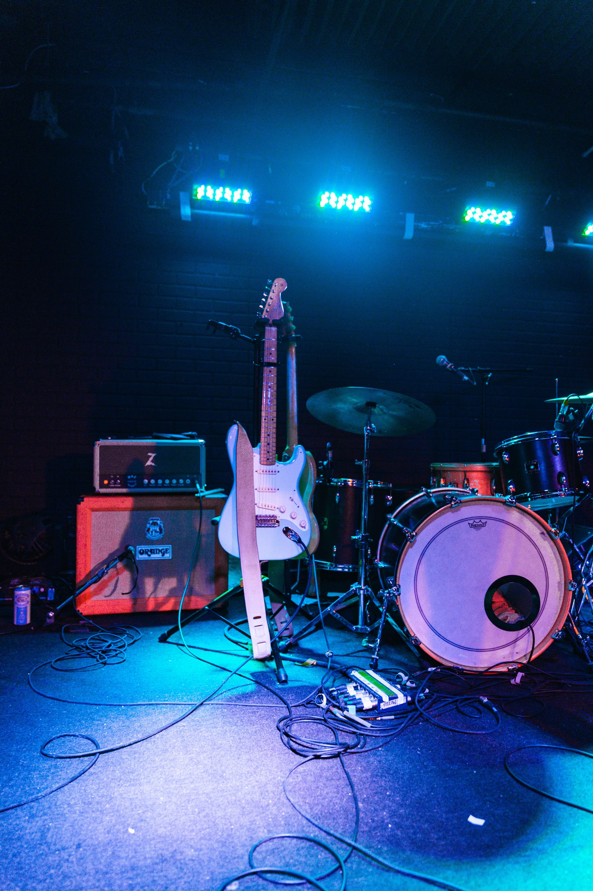

Slide 22
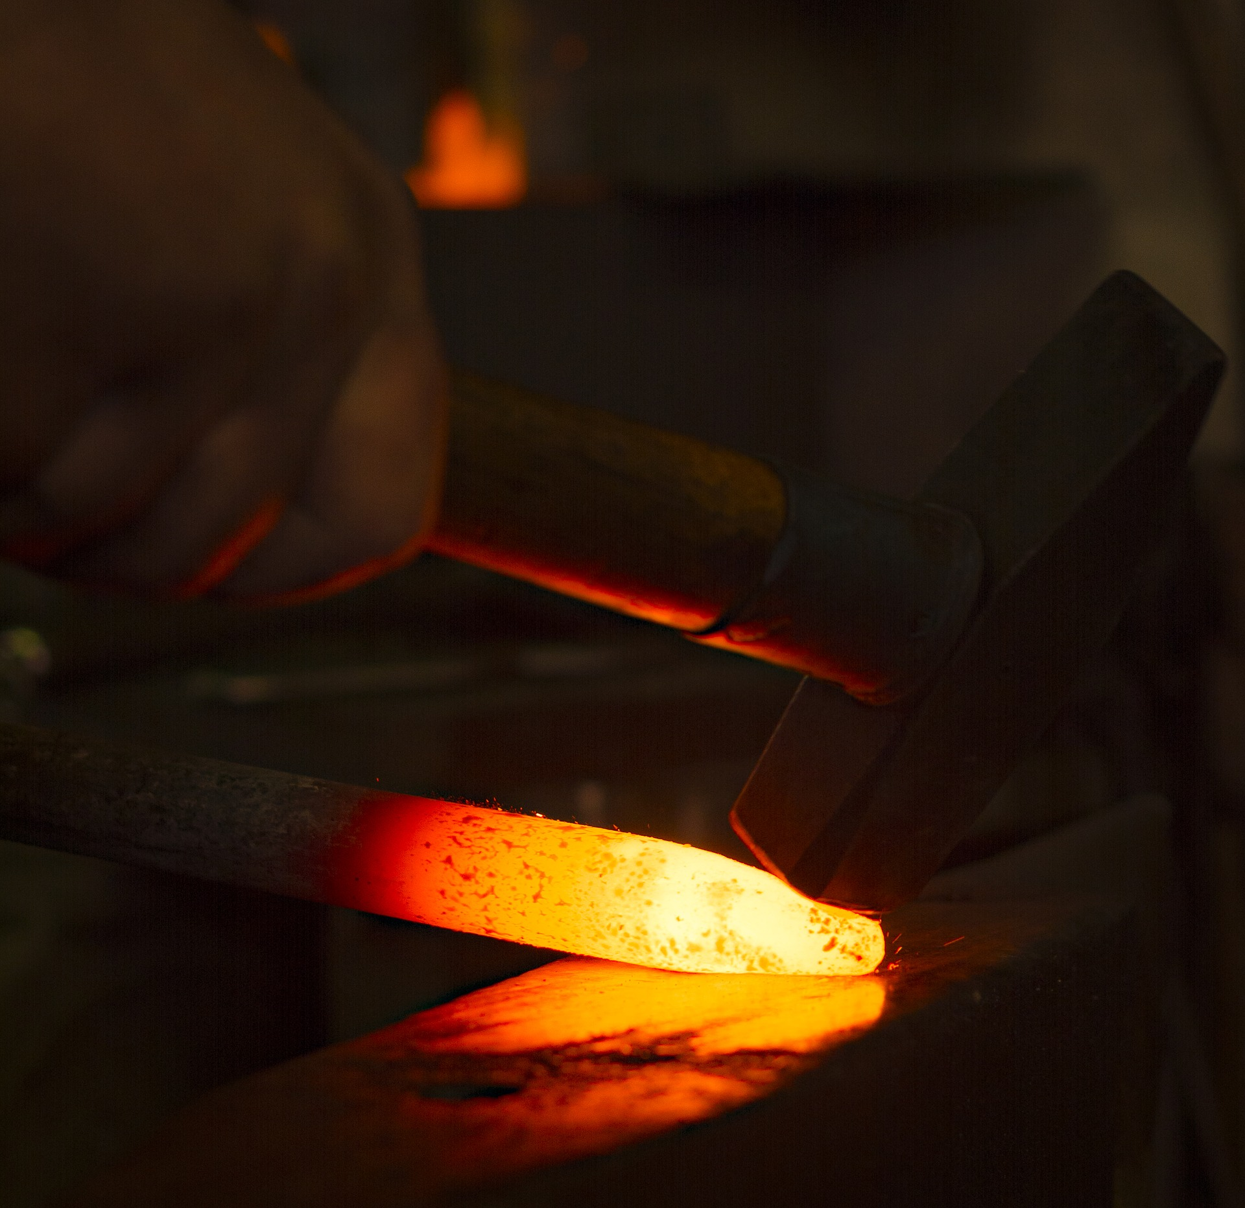

Slide 23


Slide 24


Slide 25


